Slide 1
‘Cat People’
Machine Learning Fundamentals Emily Brown November 2018

Slide 2
Table of Contents
Exploration and Augmentation of the Dataset
Questions to Investigate
Classification Approaches
Regression Approaches
Conclusions & Next Steps

Slide 3
Focus
Exploration & Augmentation of the Dataset
‘Pets’
I decided to focus on the ‘Pets’ section of the dataset, where respondents were asked to categorize their like / dislike of cats and dogs and whether they had cats and / or dogs

Slide 4
Augmentation
Exploration & Augmentation of the Dataset (cont.)
Dataset mapping based on ‘Pets’ responses
 | ‘Likes Cats’ | ‘Likes Dogs’ | ‘Has Cats’ | ‘Has Dogs’
Likes dogs & likes cats | 1 | 1 | 0 | 0
Likes dogs | 0 | 1 | 0 | 0
Likes dogs & has cats | 1 | 1 | 1 | 0
Has dogs | 0 | 1 | 0 | 1
Has dogs & likes cats | 1 | 1 | 0 | 1
Likes dogs & dislikes cats | 0 | 1 | 0 | 0
Has dogs & has cats | 1 | 1 | 1 | 1
Has cats | 1 | 0 | 1 | 0
Likes cats | 1 | 0 | 0 | 0
Has dogs & dislikes cats | 0 | 1 | 0 | 1
Dislikes dogs & likes cats | 1 | 0 | 0 | 0
Dislikes dogs & dislikes cats | 0 | 0 | 0 | 0
Dislikes cats | 0 | 0 | 0 | 0
Dislikes dogs & has cats | 1 | 0 | 1 | 0
Dislikes dogs | 0 | 0 | 0 | 0
I augmented the dataset based on the ’Pets’ responses – adding columns for ‘likes cats’ and ‘likes dogs’ and ‘has cats’ and ‘has dogs’
The data in these new columns were mapped against the responses in the ‘Pets’ section of the original dataset based upon my interpretation of their responses in a binary fashion (an important assumption in my analysis)
While having cats / dogs is binary, a person’s feelings towards cats & dogs is not necessarily binary

Slide 5
Augmentation (continued)
Exploration & Augmentation of the Dataset (cont.)
Additional new ‘mapped’ columns created in the dataset
New Column | Based on | Description
Drinks_Code | ‘Drinks’ responses | Mapped based on: ‘not at all’ (0), ‘rarely’ (1), ‘socially’ (2), ‘often’ (3), ‘very often’ (4), ‘desperately’ (5)
Drugs_Code | ‘Drugs’ responses | Mapped based on: ‘never’ (0), ‘sometimes’ (1), ‘often’ (2)
Smokes_Code | ‘Smokes’ responses | Mapped based on: ‘no’ (0), ‘sometimes’ (1), ‘when drinking’ (2), ‘trying to quit’ (4), ‘yes’ (3)
Gender | ‘Sex’ responses | Mapped based on ‘m’ (0) or ‘f’ (1)
Ed_Level_Code | ‘Education’ responses | Mapped based on various responses, from ‘dropped out of highschool’ (0) through ‘graduated from ph.d program’ (4)
Essay_Len | ‘Essay’ responses | Length of total essay responses
Essay_Cat_Count | ‘Essay’ responses | Number of times “cat” appears in total essay responses
Essay_Dog_Count | ‘Essay’ responses | Number of times “dog” appears in total essay responses
Cleaned_Exclamation_Count | ‘Essay’ responses | Total number of “!” in total essay responses
Essay_Fun_Count | ‘Essay’ responses | Number of times “fun” appears in total essay responses
Essay_Work_Count | ‘Essay’ responses | Number of times ”work” appears in total essay responses
In addition to adding the new columns based upon the ‘Pets’ responses, I also augmented the dataset by adding numerically-based columns mapped against category-based data in the dataset, in order to perform numerical analysis on the dataset
I also combined the essay responses into one string per respondent and augmented the dataset with some investigations into this string (such as overall length and frequency of certain words)

Slide 6
Exploration
Exploration & Augmentation of the Dataset (cont.)
Correlation analysis (negative correlations in “( )”)
After dropping responses that contained missing values (NaN’s), I performed a quick correlation analysis on the various numerically-categorized items in the dataset and looked for any interesting correlations (both positive and negative)
The graph to the right illustrates the absolute values of the correlations (>= 0.10)
I have highlighted some correlations that were surprising to me in red boxes (although they are not particularly strong)

Slide 7
Questions to Investigate
Classification:
Can you predict whether someone likes cats or likes dogs based on the text of their essay responses?
Can you predict whether someone likes cats based on their responses to other questions in the dataset?
Regression:
Predict age using responses to other questions in the dataset

Slide 8
Multinomial Naive Bayes Classifiers
Classification Approaches
Metrics for Multinomial NB Classifiers based on Essay responses
 | ‘Likes Cats’ | ‘Likes Dogs’ | ‘Has Cats’ | ‘Has Dogs’
Accuracy Score | 0.61 | 0.90 | 0.81 | 0.77
Recall Score | 0.56 | 0.97 | 0.12 | 0.37
Precision Score | 0.76 | 0.93 | 0.37 | 0.46
F1 Score | 0.65 | 0.95 | 0.18 | 0.41
I first looked at whether it was possible to predict whether a respondent liked cats / dogs, or had cats and / dogs, based on the text of their essay responses using Multinomial Naïve Bayes Classifiers
Overall, the classification scores were the highest for ‘Likes Dogs’ - likely reflecting that most respondents in the dataset (92%) indicated they liked dogs
The recall scores for ‘Has Cats’ and ’Has Dogs’ were low, meaning the percentage of relevant items the classifier was able to successfully find were relatively low

Slide 9
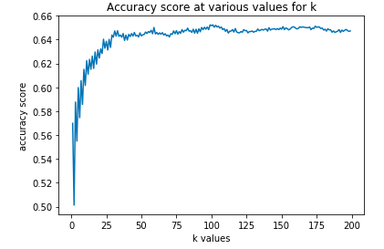
K-Nearest Neighbors Classifier
Classification Approaches (continued)
‘Likes Cats’ Classifier Accuracy
I also investigated whether it was possible to predict if someone likes cats based upon their responses to other items in the dataset, including: age, income, education level, gender, their responses to the questions on drinking, drugs and smoking, and the length of their essay responses
The accuracy score peaks at k = 170 (65%) and then starts to decline with higher levels of k
This classification approach had similar results to the Naïve Bayes approach I performed first (which had an accuracy score of 61% and F1 score of 65%)

Slide 10
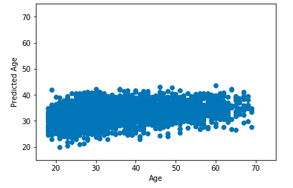
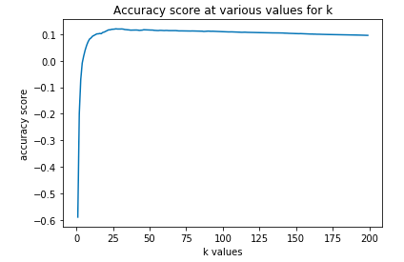
Multiple Linear Regressor and K Neighbors Regressor
Regression Approaches
Age predictions based upon Multiple Linear Regressor
Age K-Nearest Neighbors Regressor Accuracy at various values for k
For the regression portions of the analysis, I looked at the ability to predict a respondent’s age based upon their various other responses in the dataset such as income, education level, gender, their responses to the questions on drinking, drugs and smoking, whether they liked cats and dogs, and certain features of their essay responses
Unfortunately neither approach was particularly accurate, with the MLR model returning an R² of 0.1 and the k Neighbors regressor indicating a max accuracy of 12%

Slide 11
Conclusions & Next Steps
While the data showed some correlations that were surprising to me, none were exceptionally strong
Similarly, the classification and regression models did not generate results significantly above what would be expected based upon random analyses of the dataset
For further analyses, I would like to have more data regarding the actual outcomes of the respondents – who they chose to go on dates with and whether these dates successfully turned into relationships
This would likely provide insights into what is actually helpful information for OK Cupid to collect and what types of questions (and how they ask the questions) to ask

